Slide 1
Discover BOTOX® Cosmetic (onabotulinumtoxinA)
Annie was treated in her frown lines and
crow’s feet areas. Results may vary.
Please see Approved Uses and Important Safety Information on slides 2-5.
1

Slide 2
BOTOX® Cosmetic (onabotulinumtoxinA) Important Information
Approved Uses
BOTOX® Cosmetic is a prescription medicine that is injected into muscles and used to improve the look of moderate to severe frown lines between the eyebrows (glabellar lines) in adults for a short period of time (temporary).
BOTOX® Cosmetic is a prescription medicine that is injected into the area around the side of the eyes to improve the look of moderate to severe crow’s feet lines in adults for a short period of time (temporary).

Slide 3
BOTOX® Cosmetic (onabotulinumtoxinA) IMPORTANT SAFETY INFORMATION
BOTOX® Cosmetic may cause serious side effects that can be life threatening. Call your doctor or get medical help right away if you have any of these problems any time (hours to weeks) after injection of BOTOX® Cosmetic:
Problems swallowing, speaking, or breathing, due to weakening of associated muscles, can be severe and result in loss of life. You are at the highest risk if these problems are pre-existing before injection. Swallowing problems may last for several months
Spread of toxin effects. The effect of botulinum toxin may affect areas away from the injection site and cause serious symptoms including: loss of strength and all-over muscle weakness, double vision, blurred vision and drooping eyelids, hoarseness or change or loss of voice (dysphonia), trouble saying words clearly (dysarthria), loss of bladder control, trouble breathing, trouble swallowing. If this happens, do not drive a car, operate machinery, or do other dangerous activities
The dose of BOTOX® Cosmetic is not the same as, or comparable to, any other botulinum toxin product.
There has not been a confirmed serious case of spread of toxin effect when BOTOX® Cosmetic has been used at the recommended dose to treat frown lines, crow’s feet lines or both at the same time.

Slide 4
BOTOX® Cosmetic (onabotulinumtoxinA) IMPORTANT SAFETY INFORMATION (continued)
Serious and/or immediate allergic reactions have been reported. They include: itching, rash, red itchy welts, wheezing, asthma symptoms, or dizziness or feeling faint. Tell your doctor or get medical help right away if you are wheezing or have asthma symptoms, or if you become dizzy or faint.
Do not take BOTOX® Cosmetic if you: are allergic to any of the ingredients in BOTOX® Cosmetic (see Medication Guide for ingredients); had an allergic reaction to any other botulinum toxin product such as Myobloc ® (rimabotulinumtoxinB), Dysport ® (abobotulinumtoxinA), or Xeomin ® (incobotulinumtoxinA); have a skin infection at the planned injection site.
Tell your doctor about all your muscle or nerve conditions, such as amyotrophic lateral sclerosis (ALS or Lou Gehrig’s disease), myasthenia gravis, or Lambert-Eaton syndrome, as you may be at increased risk of serious side effects including severe dysphagia (difficulty swallowing) and respiratory compromise (difficulty breathing) from typical doses of BOTOX® Cosmetic.
Tell your doctor about all your medical conditions, including: plans to have surgery; had surgery on your face; weakness of forehead muscles, such as trouble raising your eyebrows; drooping eyelids; any other abnormal facial change; are pregnant or plan to become pregnant (it is not known if BOTOX® Cosmetic can harm your unborn baby); are breast-feeding or plan to breast-feed (it is not known if BOTOX® Cosmetic passes into breast milk).

Slide 5
BOTOX® Cosmetic (onabotulinumtoxinA) IMPORTANT SAFETY INFORMATION (continued)
Tell your doctor about all the medicines you take, including prescription and nonprescription medicines, vitamins, and herbal products. Using BOTOX® Cosmetic with certain other medicines may cause serious side effects. Do not start any new medicines until you have told your doctor that you have received BOTOX® Cosmetic in the past.
Especially tell your doctor if you: have received any other botulinum toxin product in the last 4 months; have received injections of botulinum toxin, such as Myobloc ®, Dysport ®, or Xeomin ® in the past (be sure your doctor knows exactly which product you received); have recently received an antibiotic by injection; take muscle relaxants; take an allergy or cold medicine; take a sleep medicine; take anti-platelets (aspirin-like products) or anti-coagulants (blood thinners).
Other side effects of BOTOX® Cosmetic include: dry mouth, discomfort or pain at the injection site, tiredness, headache, neck pain, and eye problems: double vision, blurred vision, decreased eyesight, drooping eyelids, swelling of your eyelids, and dry eyes.
For more information refer to the Medication Guide or talk with your doctor.
To report a side effect, please call Allergan at 1-800-433-8871.
Full Product Information, including Boxed Warning and Medication Guide, will be
provided to you after this presentation by your aesthetic provider.

Slide 6
Real Results That Are True to You
This presentation provides important information about BOTOX® Cosmetic (onabotulinumtoxinA), the #1 selling product of its kind in the world.^{1,*}
*Data collected through September 2013.
Hollis was treated in her frown lines and crow’s feet areas. Results may vary.
1. Data on file, Allergan, Inc., September 2013.
Please see Approved Uses and Important Safety Information on slides 2-5.

Slide 7
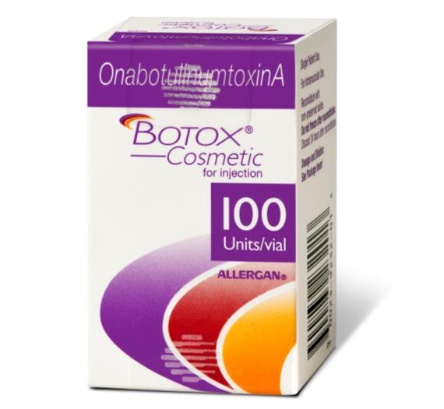
What Is BOTOX® Cosmetic (onabotulinumtoxinA)?
BOTOX® Cosmetic is the first and only FDA-approved product to temporarily improve the appearance of both moderate to severe frown lines between the brows and crow’s feet lines around the sides of the eyes.
Please see Approved Uses and Important Safety Information on slides 2-5.

Slide 8
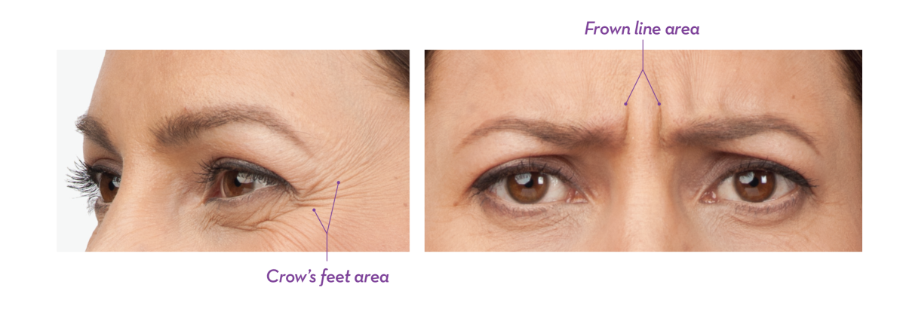
Moderate to Severe Crow’s Feet and Frown Lines: Why They Happen
Repeated muscle contractions from squinting and frowning over the years are one of the reasons your skin can crease and furrow.
That’s why you keep seeing those moderate to severe crow’s feet or frown lines when you look in the mirror.
You can ask your doctor about treating these 2 areas in just 1 visit,¹ and that’s the beauty of BOTOX® Cosmetic (onabotulinumtoxinA)
1. BOTOX® Cosmetic Prescribing Information, September 2013.
Please see Approved Uses and Important Safety Information on slides 2-5.

Slide 9
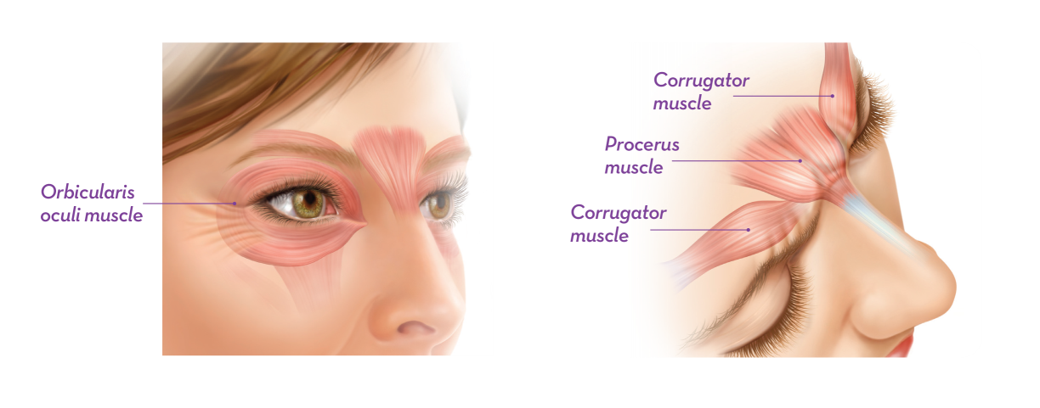
How Does BOTOX® Cosmetic (onabotulinumtoxinA) Work?
BOTOX® Cosmetic targets one of the underlying causes of crow’s feet and frown lines—those repeated muscle contractions.
Your doctor will inject BOTOX® Cosmetic into the muscle surrounding the side of your eye—the orbicularis oculi—to treat crow’s feet.
For treatment of frown lines, BOTOX® Cosmetic is injected into 2 muscles—the corrugator and procerus muscles.
Please see Approved Uses and Important Safety Information on slides 2-5.

Slide 10
Will BOTOX® Cosmetic (onabotulinumtoxinA) Make Me Look Like I’ve Had Work Done?
When BOTOX® Cosmetic is administered by an experienced injector, you should not lose the ability to show expressions.
Talk to your doctor to determine whether BOTOX® Cosmetic is right for you—and discuss the results you want to achieve with treatment, as well as the precautions and risks.
Approximately 10-minute noninvasive procedure with minimal downtime!
Annie, Hollis, and Melissa were treated in their frown lines and crow’s feet areas. Results may vary.
Please see Approved Uses and Important Safety Information on slides 2-5.

Slide 11
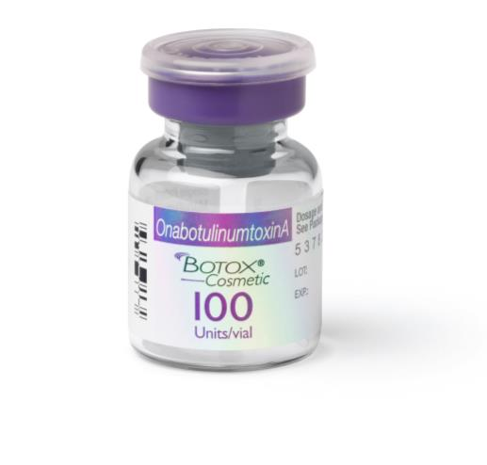
About BOTOX® Cosmetic (onabotulinumtoxinA)
BOTOX® Cosmetic is a biologic product that contains a purified protein and 2 inactive ingredients
Vaccines are another type of biologic. Made from living organisms, each biologic is unique¹
Unit dosing and formulations are unique to each botulinum toxin product,² which means that products are not interchangeable
Each biologic is unique.¹
That’s why there is no such thing as a “generic” form of BOTOX® Cosmetic.³
1. US FDA website. Accessed 2014; 2. BOTOX® Cosmetic Prescribing Information, September 2013; 3. Roger and Mikhail. J Pharm Pharm Sci. 2007.
Please see Approved Uses and Important Safety Information on slides 2-5.

Slide 12
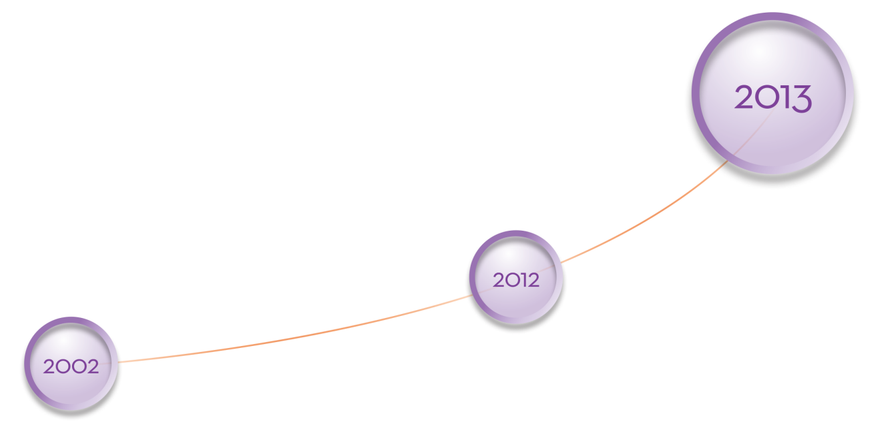
Discover Experience You Can Trust
BOTOX® Cosmetic: first and only FDA-approved product for crow’s feet AND frown lines.
Since 2002, approximately
11 million procedures have been performed for moderate to severe frown lines.¹
#1 selling product of its kind in the world^{2,*}
BOTOX® Cosmetic celebrates 10 years.
*Data collected through September 2013.
BOTOX® Cosmetic (onabotulinumtoxinA): first botulinum toxin approved for moderate to severe frown lines.
1. Data on file, Allergan, Inc., March 25, 2009; 2. Data on file, Allergan, Inc., September 2013.
Please see Approved Uses and Important Safety Information on slides 2-5.

Slide 13
People Like You
8 out of 10 BOTOX® Cosmetic (onabotulinumtoxinA) patients surveyed (n = 299) expect to continue treatment¹
And, approximately 9 out of 10 BOTOX® Cosmetic patients surveyed (n = 297) are willing to tell friends and family about their treatment¹
1. Facial Injectable Consumer User Tracker, May 2013.
Please see Approved Uses and Important Safety Information on slides 2-5.

Slide 14
Real, Noticeable Results
Moderate to severe crow’s feet
Actual patients. Results may vary.
Photos taken at full smile before and after treatment with BOTOX® Cosmetic (onabotulinumtoxinA) at day 7. In two clinical studies, 26.1% and 20.3% of people had ≥ 2-grade improvement at day 30.¹ In one of these studies, 67.9% of people had mild or no crow’s feet at day 30 after treatment.²
Side effects associated with the injection include localized pain, infection, inflammation, tenderness, swelling, redness, and/or bleeding/bruising.¹
1. BOTOX® Cosmetic Prescribing Information, September 2013;
2. Data on file, Allergan, Inc., December 30, 2013.
Please see Approved Uses and Important Safety Information on slides 2-5.

Slide 15
Real, Noticeable Results (cont)
Moderate to severe frown lines
Actual patients. Results may vary.
Photos taken at maximum frown before and after treatment with BOTOX® Cosmetic (onabotulinumtoxinA) at day 7, month 3, and month 4. In clinical studies, physicians assessed 74% of people had significant improvement at day 7; 80% of people had significant improvement at day 30; 48% of people had significant improvement at month 3; and 25% of people had significant improvement at month 4.¹
Side effects associated with the injection include localized pain, infection, inflammation, tenderness, swelling, redness, and/or bleeding/bruising.¹
1. BOTOX® Cosmetic Prescribing Information, September 2013.
Please see Approved Uses and Important Safety Information on slides 2-5.

Slide 16
Discover the Rewards
Reward yourself: enroll today
Join the consumer rewards program with exclusive offers and savings on leading aesthetic products from Allergan:
Earn points with every BOTOX® Cosmetic (onabotulinumtoxinA) treatment that you can redeem for savings on future treatments
You can also earn and redeem points for other qualifying Allergan Aesthetics products
Join our consumer rewards program and start earning today:
Visit BotoxCosmetic.com
Please see Approved Uses and Important Safety Information on slides 2-5.

Slide 17
Is This Your Year for BOTOX® Cosmetic (onabotulinumtoxinA)?
Ask your aesthetic provider today.
Be sure to ask about today’s special offers.
Melissa was treated in her frown lines and crow’s feet areas. Results may vary.
Please see Approved Uses and Important Safety Information on slides 2-5.

Slide 18
Bibliography
BOTOX® Cosmetic Prescribing Information, September 2013.
Data on file, Allergan, Inc., March 25, 2009.
Data on file, Allergan, Inc., September 2013.
Data on file, Allergan, Inc., December 30, 2013.
Facial Injectables Consumer User Survey; May 2013.
Roger SD, Mikhail A. Biosimilars: opportunity or cause for concern? J Pharm Pharm Sci. 2007;10(3):405-410.
US Food and Drug Administration. Frequently asked questions about therapeutic biological products. US Food and Drug Administration website. http://www.fda.gov/Drugs/DevelopmentApprovalProcess /HowDrugsareDevelopedandApproved/ApprovalApplications/TherapeuticBiologicApplications/ucm113522.htm. Updated December 24, 2009. Accessed April 25, 2014.
©2014 Allergan, Inc., Irvine, CA 92612 ® and ™ marks owned by Allergan, Inc. Dysport is a registered trademark of Ipsen Biopharm Limited. Myobloc is a registered trademark of Solstice Neurosciences, Inc. Xeomin is a registered trademark of Merz Pharma GmbH & Co. KGaA. www.botoxcosmetic.com 1-800-BOTOXMD APC54PS14 141808

